Slide 1

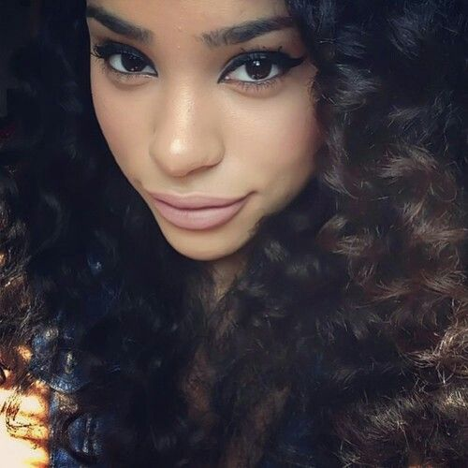
Log In Here
Log In Here
Log in Here
Beauty
Email
Hair
Fashion

Slide 2
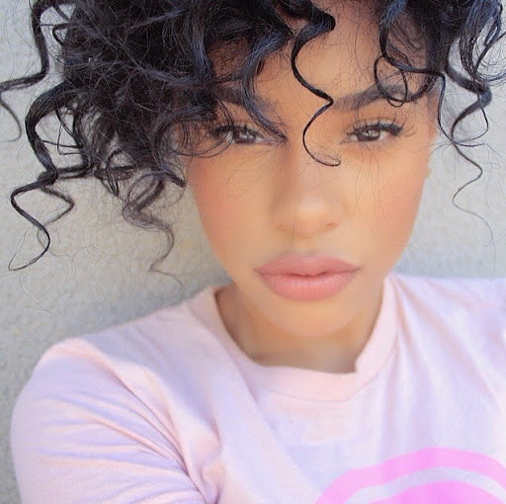
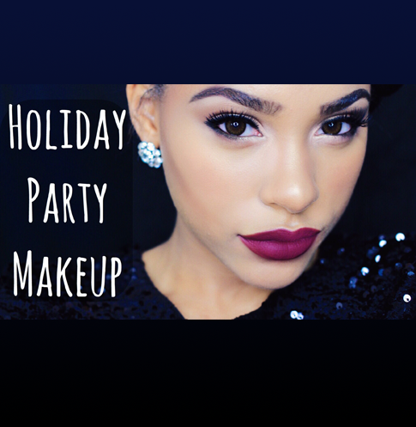

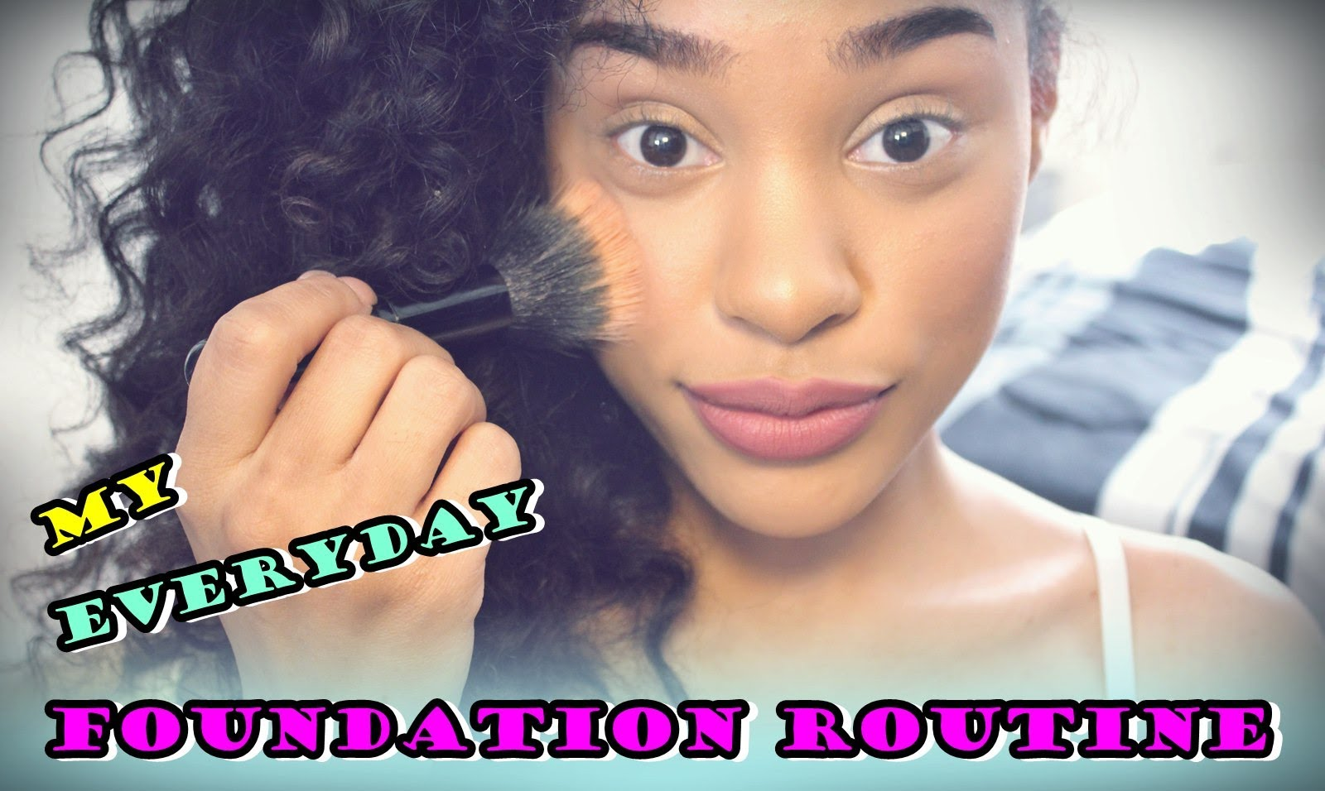
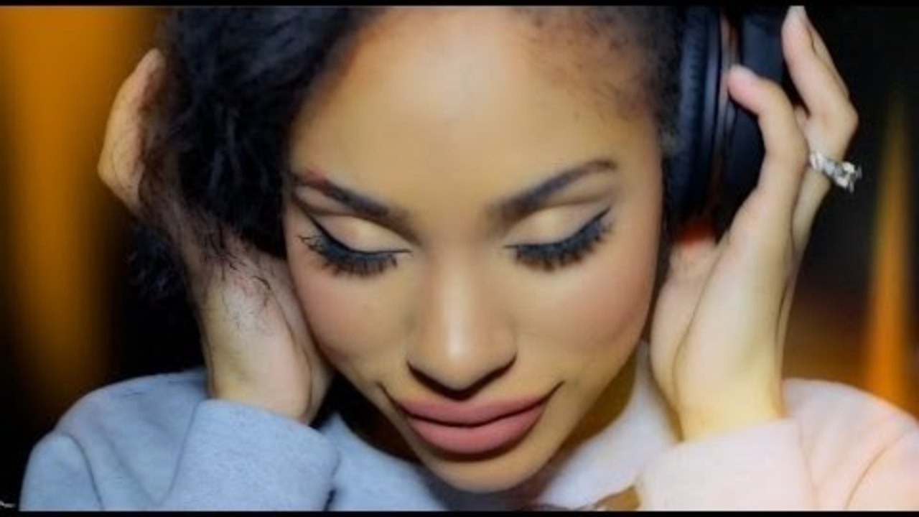
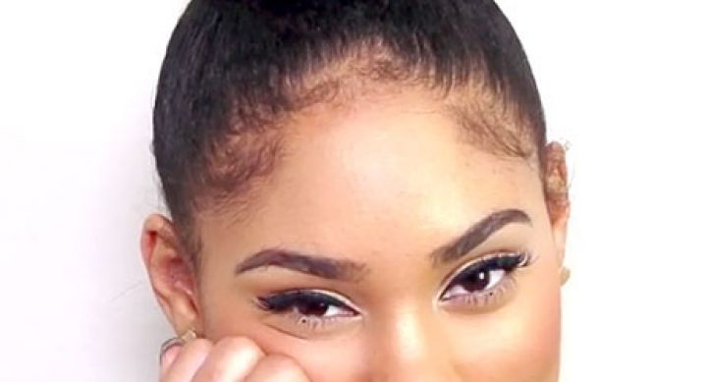
YouTube
Description text from YouTube.
Blah, blah, blah, blah, blah, blah
Blah, blah, blah, blah, blah.
Social
Description text from YouTube.
Blah, blah, blah, blah, blah, blah
Blah, blah, blah, blah, blah.
Events
News
Description text from YouTube.
Blah, blah, blah, blah, blah, blah
Blah, blah, blah, blah, blah.

Slide 3



Luv this holiday make-up tutorial with bold eyes & lips!
YouTube
Social
Events
Ad
News

